Slide 1


Slide 2
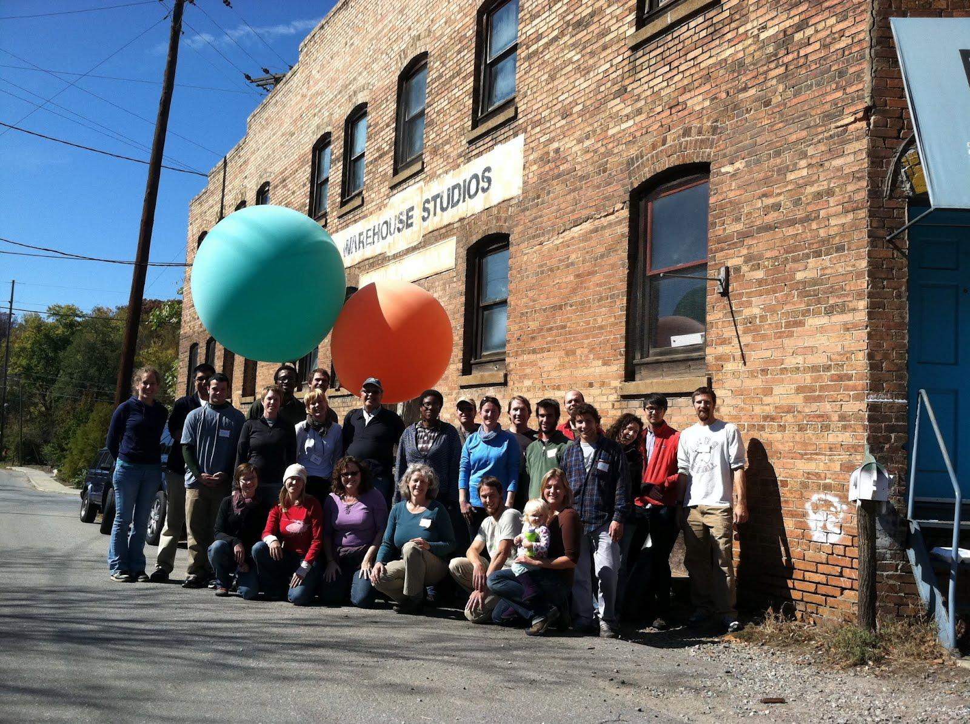
Public Laboratory Map Tools
open source aerial imagery & mapmaking

Slide 3
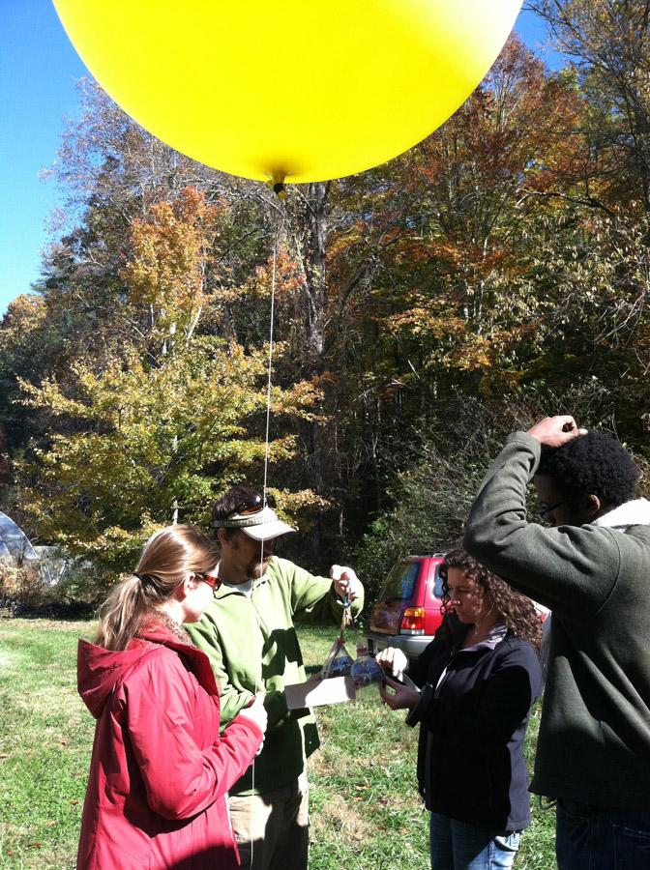
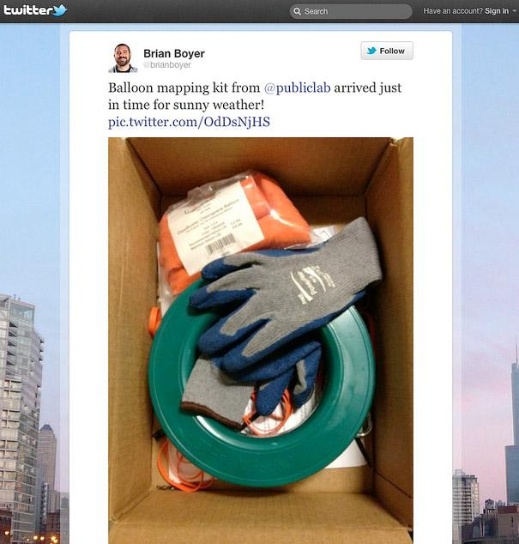
350+ of users
340+ published maps

Slide 4
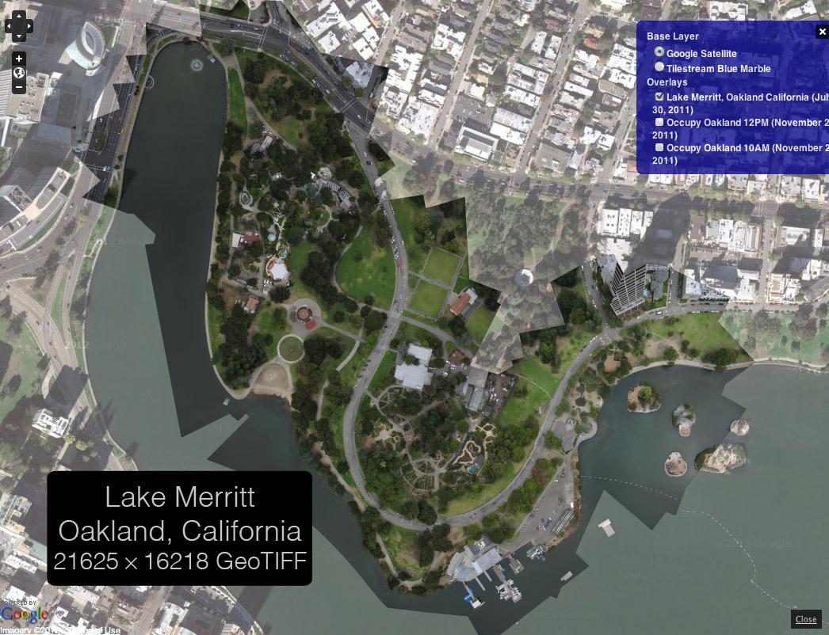

Slide 5
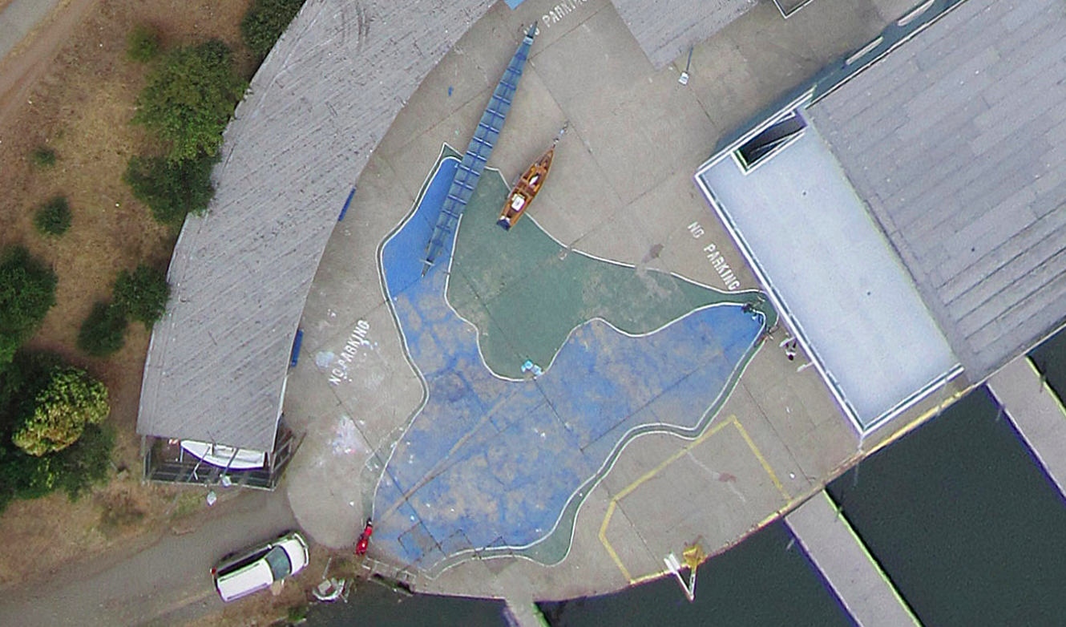
1:1 at the boat house, with their map of the park
Lake Merritt

Slide 6
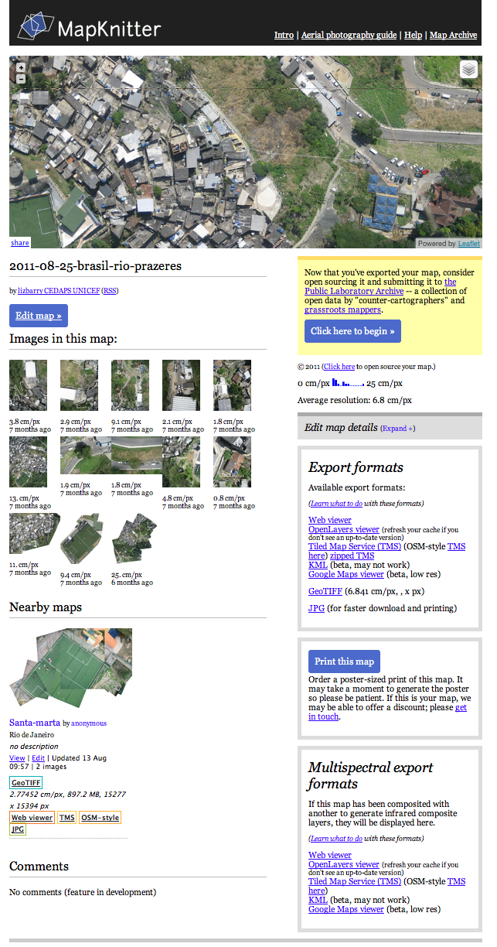
MapKnitter.org
map viewer
publish to the public domain
(or as private)
project images
nearby and related maps
map export
nearby/related maps
printing
multispectral support
commenting/authors

Slide 7
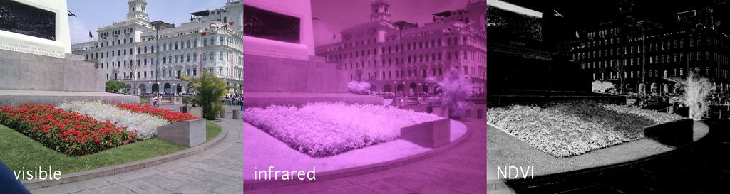
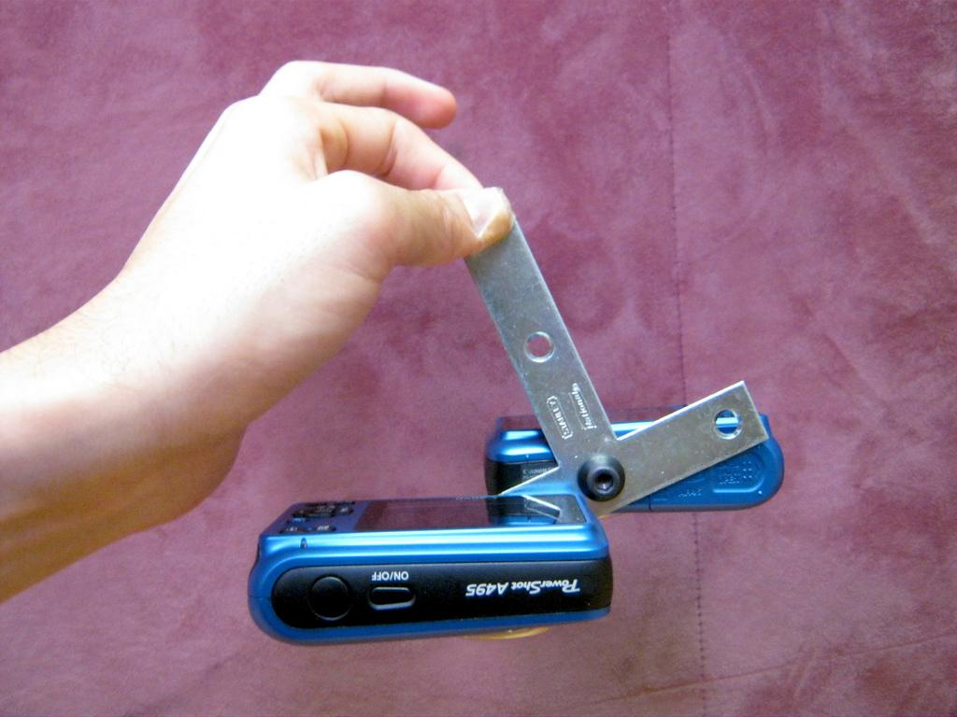
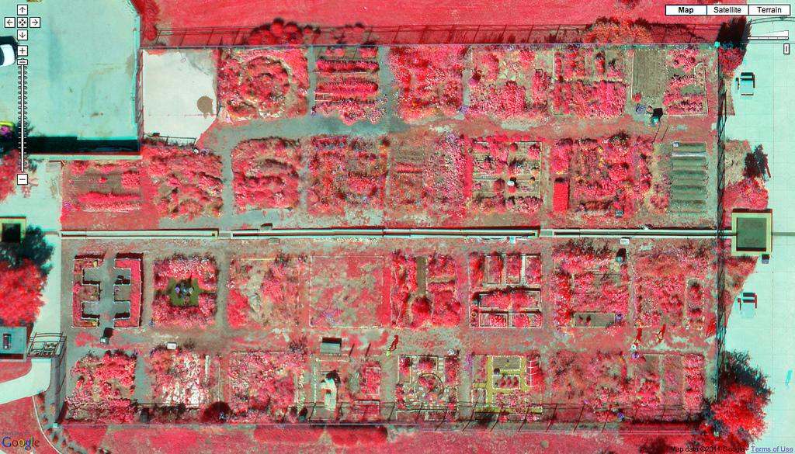
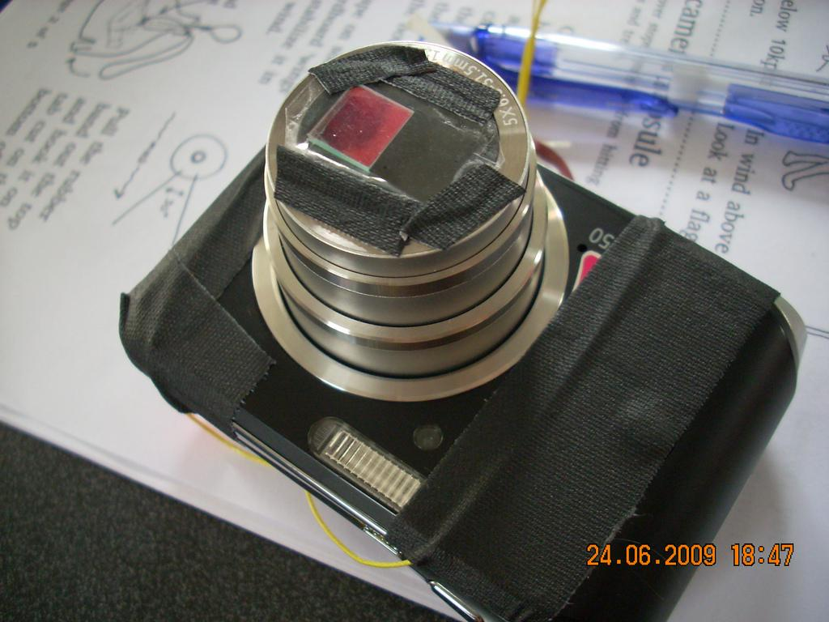
Vegetation Analysis, NRG/NDVI
NRG

Slide 8
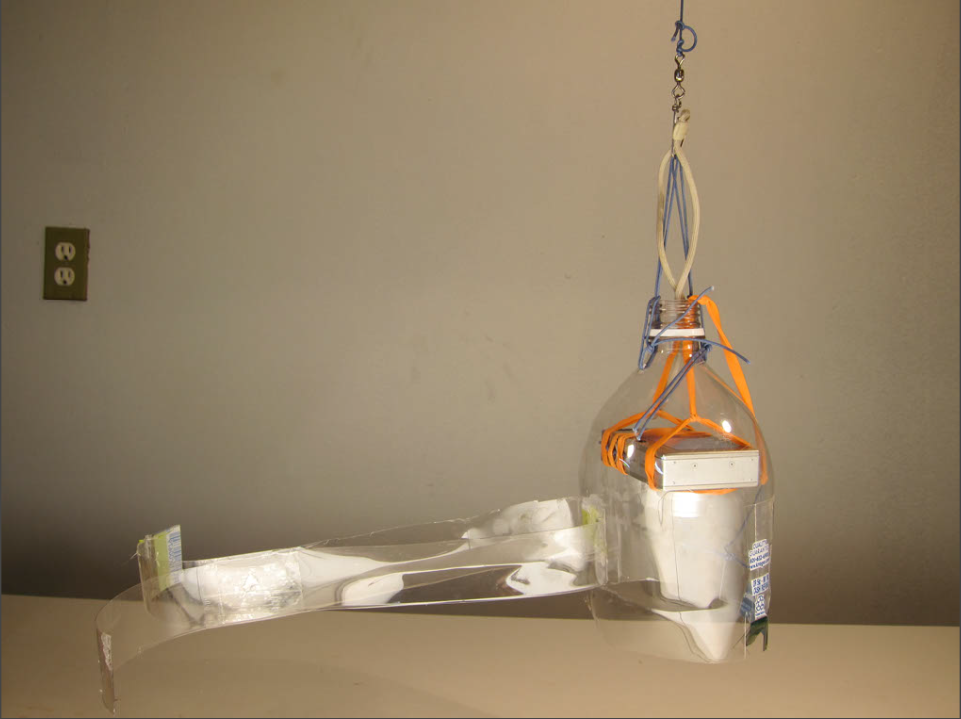
PET Bottle and Rubber Band Rigging
zoom-out video of Map>>>End
shock mounted
wind stabilized

Slide 9
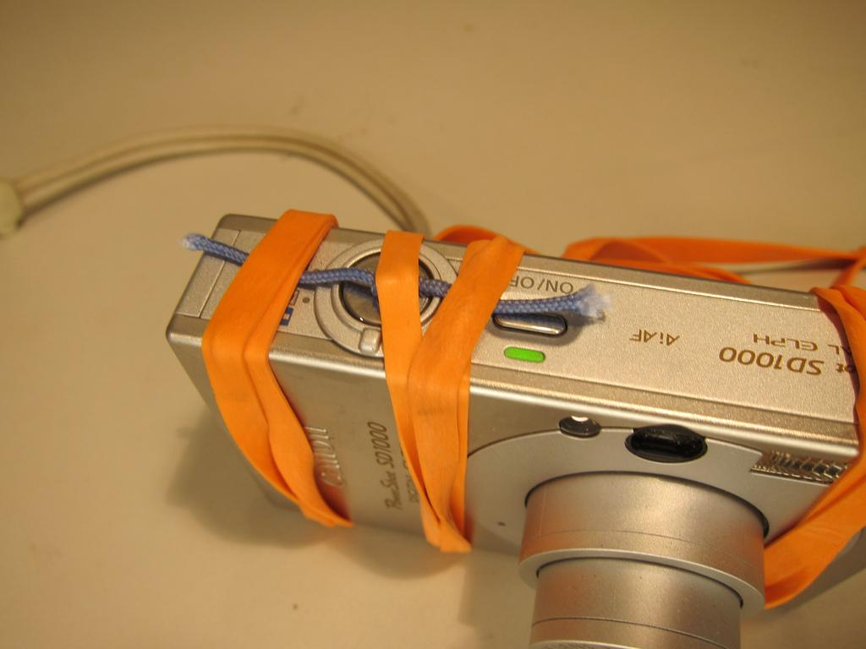
Whenever Possible:
Simple Solutions, Not Software
continuous shooting

Slide 10
publiclaboratory.org

